Slide 1
Lazy Learners- K Nearest Neighbor Classifier

Slide 2
Types of learners
There are two types of learners in classification as lazy learners and eager learners.
1.Lazy learners
Eg. k-nearest neighbor, Case-based reasoning
2. Eager learners
Eg
1. decision tree induction
2. Bayesian classification
3. rule-based classification
4. classification by backpropagation
5. support vector machines
6. classification based on association rule mining

Slide 3
Eager learners
Eager learners construct a classification model based on the given training data before receiving data for classification.
It must be able to commit to a single hypothesis that covers the entire instance space.
Due to the model construction, eager learners take a long time for train and less time to predict.

Slide 4
Lazy learners
Lazy learners simply store the training data and wait until a testing data appear.
When it does, classification is conducted based on the most related data in the stored training data.
Compared to eager learners, lazy learners have less training time but more time in predicting.

Slide 5
Eg of lazy learners
Typical approaches of lazy learning:
–k-nearest neighbor approach
Instances represented as points in a Euclidean space.
–Case-based reasoning
Uses symbolic representations and knowledge-based
Locally weighted regression
Constructs local approximation

Slide 6
k-Nearest-Neighbor Method
Described in the early 1950s
It has since been widely used in the area of pattern recognition.
The training instances are described by n attributes.
Each instance represents a point in an n-dimensional space.
A k-nearest-neighbor classifier searches the pattern space for the k training instances that are closest to the unknown instance.

Slide 7
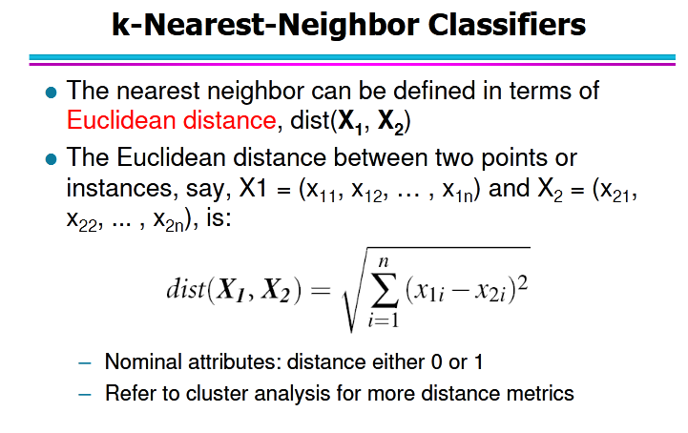

Slide 8
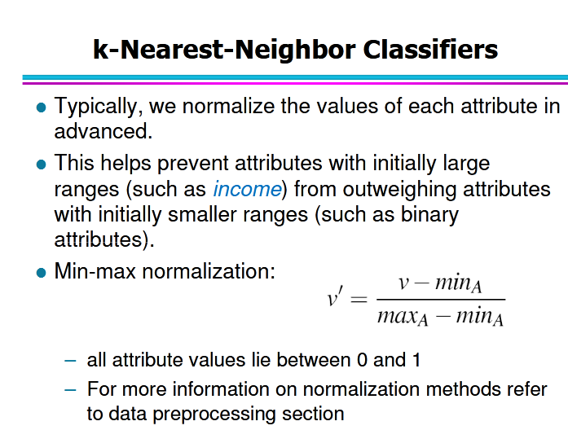

Slide 9
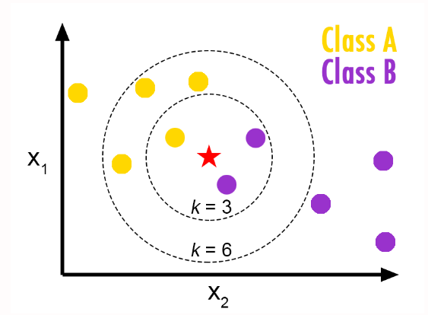
Eg KNN
For k=3 ,the class is B
For k=6 ,the class is A

Slide 10
Eg KNN
The red star represents our test data point whose value is ( 2 , 1 , 3 ) .
Our test point is surrounded by yellow and blue dots which represent our 2 classes.
Now , we find out the distance from our test point to each of the dots present on the graph.
Since there are 10 dots , we get 10 distances.
We determine the lowest distance and predict that it belongs to the same class of its nearest neighbor.
If , a yellow dot is the closest ,then we predict that our test data point is also a yellow dot.

Slide 11
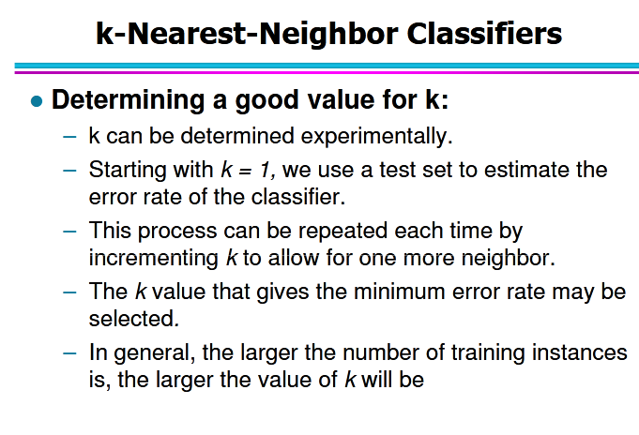

Slide 12
KNN Algorithm
We can implement a KNN model by following the below steps:
Load the load the training as well as test data
Initialize the value of k
For getting the predicted class, iterate from 1 to total number of training data points
3.1 Calculate the distance between test data and each row of training data. The distance can be calculated using Euclidean, Manhattan or Hamming distance. The most commonly used method to calculate distance is Euclidean
3.2 Sort the calculated distances in ascending order based on distance values
3.3 Get top k rows from the sorted array
3.4 Get the most frequent class of these rows
3.5 Return the predicted class
4. End

Slide 13
Advantages of KNN Algorithm:
It is simple to implement.
It is robust to the noisy training data
It can be more effective if the training data is large.
There’s no need to build a model, tune several parameters, or make additional assumptions

Slide 14
Disadvantages of KNN Algorithm:
Always needs to determine the value of K which may be complex some time.
The computation cost is high because of calculating the distance between the data points for all the training samples.

Slide 15
Problems
We want to classify an instance x into one of two classes C1 and C2. Class labels of ten other training set instances sorted in increasing order of their distance to x is as follows: {C1, C2, C1, C2, C2, C2, C1, C2, C1, C2}. How will a K=5 nearest neighbor classifier classify x?
A. There will be a tie
B. C1
C. C2
D. Not enough information to classify

Slide 16
Answer is
C. C2

Slide 17
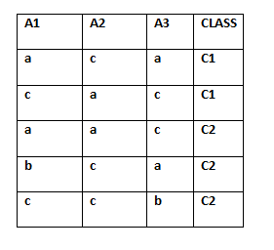
You are given the following set of training examples. Each attribute can take on one of three nominal values: a, b, or c.
Test data
a
c
b
1 C1
2 C2
2 C2
3 C2
5 C1
1
0+0+1=1
2
2+2+1=5
0+2+1=3
3
4
1+0+1=2
5
2+0+0=2

Slide 18
Question 1
Suppose we define the distance between two instances as follows.
Difference between two attribute values is the absolute difference in position of their alphabets, e.g., difference (a, b) = 1, and difference(c, a) = 2.
Distance between two instances is the sum of their attribute value differences, e.g., distance between first two instances is 6.
Using this distance function 1-nearest neighbor rule would classify the instance A1 = a, A2 = c, A3 = b, as?

Slide 19
Ans C1

Slide 20
Question 2
Suppose we define the distance between two instances as follows. Difference between two attribute values is the absolute difference in position of their alphabets, e.g., difference (a, b) = 1, and difference(c, a) = 2. Distance between two instances is the sum of their attribute value differences, e.g., distance between first two instances is 6. Using this distance function 3-nearest neighbor rule would classify the instance A1 = a, A2 = c, A3 = b, as?

Slide 21
Ans :C2

Slide 22
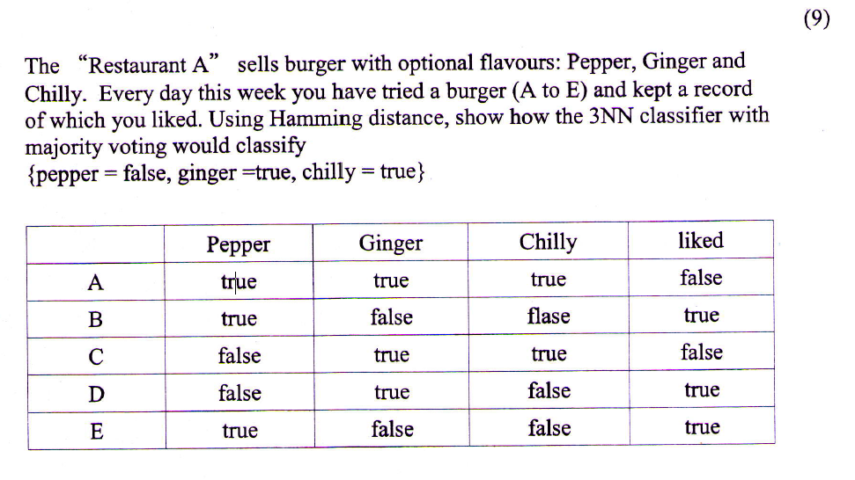
UNIVERSITY QUESTION

Slide 23
Hamming Distance
Hamming Distance between two integers is the number of bits that are different at the same position in both numbers
Example Find the distance between the vectors 01101010 and 11011011.
01101010
11011011
They differ in four places, so the Hamming distance d(01101010, 11011011) = 4.

Slide 24
Solution
Hamming DISTANCE
Test data
0
1
1
 | PEPPER | GINGER | CHILLY | LIKED
A | 1 | 1 | 1 | 0
B | 1 | 0 | 0 | 1
C | 0 | 1 | 1 | 0
D | 0 | 1 | 0 | 1
E | 1 | 0 | 0 | 1
1
3
0
1
3

Slide 25
The class label of top 3 rows (K=3) are the following
C-0
A-0
D-1
Here the majority belongs to class false. So the test data is assigned to class false

